Slide 1
NetLogo & R
Thorben Jensen

Slide 2



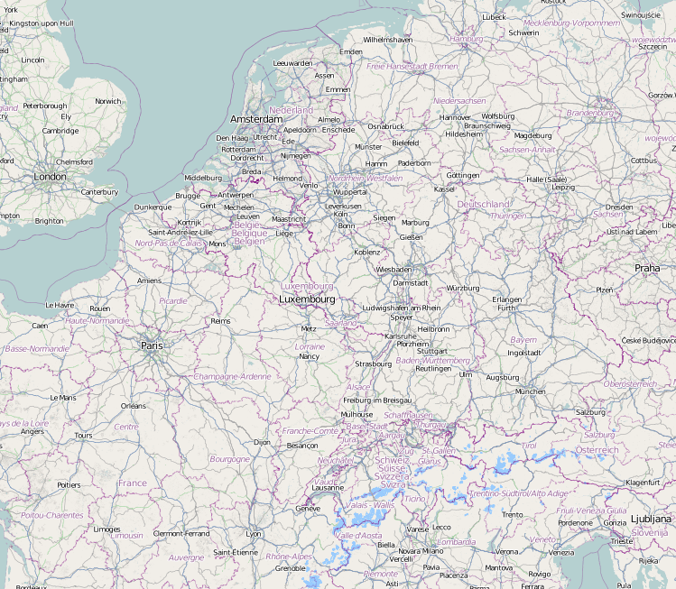

Thorben Jensen
thorben.jensen@wupperinst.org
Delft
Wuppertal
You are here

Slide 3
Content of Class
Importance of statistics for NetLogo
Basic R usage
Use cases for R with NetLogo
Application of use cases

Slide 4
Motivation

Slide 5

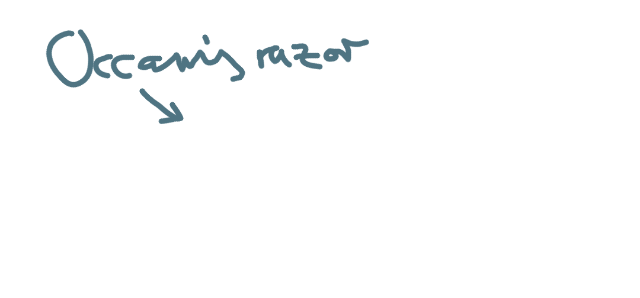
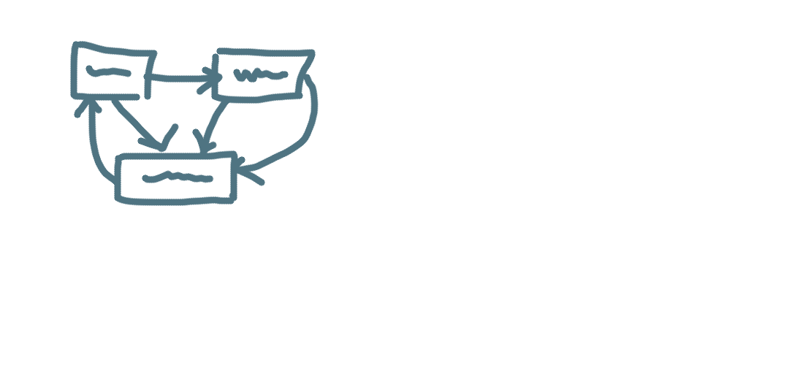


Agent-based modeling
Brainstorming,
Question
Paper model
Hypotheses ∙ Scales ∙ Assumptions
Variables ∙ Parameters
Bug search
Implementation
Documentation
ifelse N > x
[grow] [die]
Verification
Analysis
Validation
Parameterization
Communication
Scenario Analysis
Sensitivity Analysis

Slide 6
Why Statistics for NetLogo?
Emergence (model rules ≠ results)
Stochasticity
Ensembles intead of single runs!
Describe results
Descriptive statistics
Test causality
Assumption (e.g. parameter) -> Implication
Give meaning to results
„Show that the seemingly complex is simple“
e.g. fitting equations
Notes:
END: we need a statistical tool for this – the tool to learn today is R

Slide 7

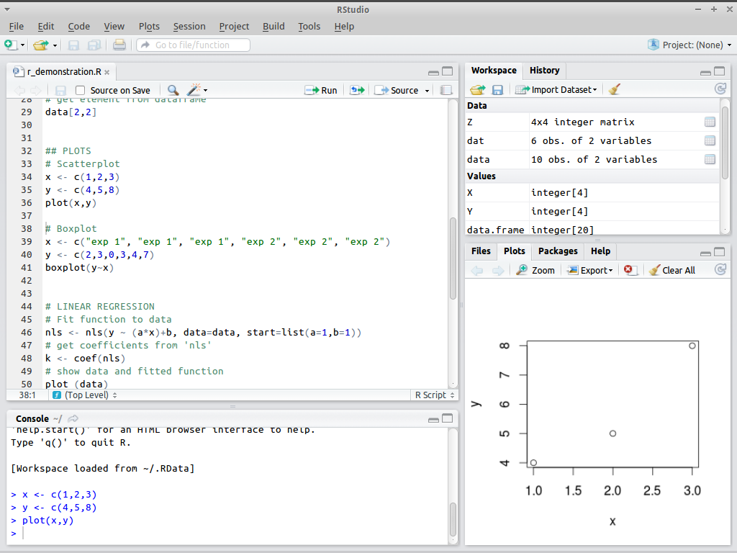
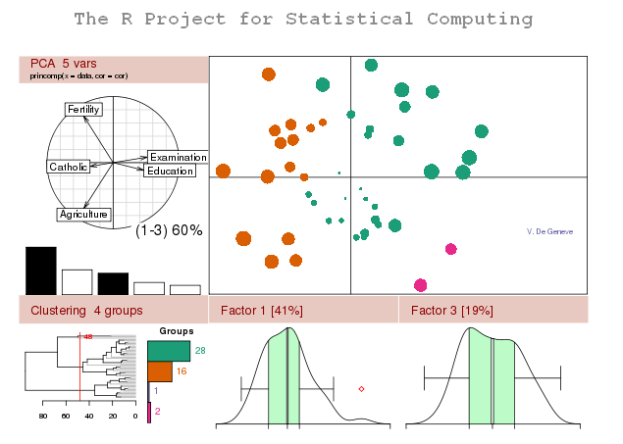
What is R?
Powerful statistics tool
Free software & language for statistics and beyond
www.r-project.org
Notes:
* START: interactive – who knows R?

Slide 8
How do you do it? – Use cases
NetLogo -> R
When calculation in NetLogo not possible
When coding in NetLogo is too clumsy
R -> NetLogo (RNetLogo)
When mainly working in R
R: More controlled environment
Behavior Space -> R
‚Data mining‘ on big result data
Notes:
Start interactively, asking the students
END: this way you can use statistical power for

Slide 9
TOOL Demonstration
NetLogo R extension +++ RNetLogo +++ BehaviorSpace and R

Slide 10


extension [r]
Execute R-commands from within NetLogo
http://r-ext.sourceforge.net
Notes:
QUESTION: why do we need it, again?

Slide 11
Using extension [r]
Procedures tab: extensions [r]
Type in observer on Interface tab:
r:clear
show r:get “1 + 1“
r:put "x" <- [xcor] of fires
r:get "y"
r:eval "hist(x)"
r:eval "qqnorm(x)"
r:eval "qqline(x)"
r:put "y" <- [ycor] of fires
r:eval "plot(x,y)"
From r-extension tutorial by J.C. Thiele & V. Grimm

Slide 12
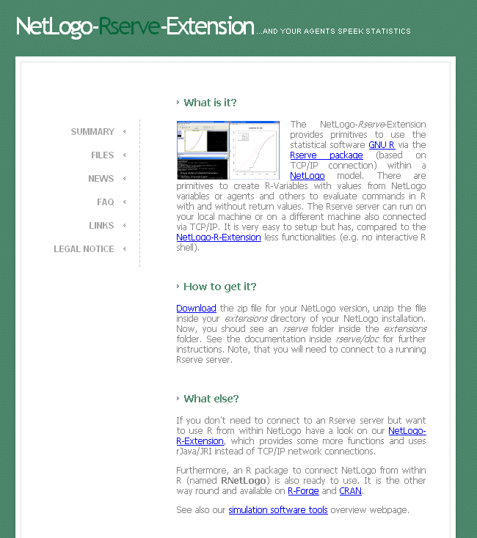
Alternative: Rserve
Same purpose, but based on TCP/IP connection
http://rserve-ext.sourceforge.net
Advanages
Installation easier
no environment variables
Disadvantages
Rserve server is needed
Fewer functionalities

Slide 13
The other way round: RNetLogo
RNetLogo makes NetLogo available from R
http://rnetlogo.r-forge.r-project.org
Very useful for the analysis of model output or for sensitivity analysis of a model
Notes:
QUESTION: why do we need it, again?

Slide 14
Using RNetLogo
Getting started:
library(RNetLogo)
nl.path <- "C:/Program Files/NetLogo 5.0"
NLStart(nl.path) # OR: NLStart(nl.path gui = TRUE, nl.version = 5)
model.path <- "/models/Sample Models/Earth Science/Fire.nlogo"
NLLoadModel(paste(nl.path,model.path,sep=""))
NLCommand("set density 77")
NLCommand("setup")
NLCommand("go")
NLCommand("print \"Hello NetLogo, I called you from R.\"")
From RNetLogo Tutorial by J.C. Thiele & V. Grimm

Slide 15
Using RNetLogo
… continued…
density.in.r <- 88
NLCommand("set density ",density.in.r,"setup","go")
NLDoCommand(10, "go")
NLReport("ticks")
ticks <- NLReport("ticks")
print(ticks)
NLCommand("setup")
burned<-NLDoReportWhile("any? turtles", "go",c("ticks","(burned-trees / initial-trees) * 100"), as.data.frame=TRUE,df.col.names=c("tick","burned"))
plot(burned,type="s")
NLQuit()
From RNetLogo Tutorial by J.C. Thiele & V. Grimm

Slide 16

BehaviorSpace & R
Native part of NetLogo
Design, set up and run simulation experiments
Scan parameter space
Notes:
QUESITON: why do we need it, again?

Slide 17
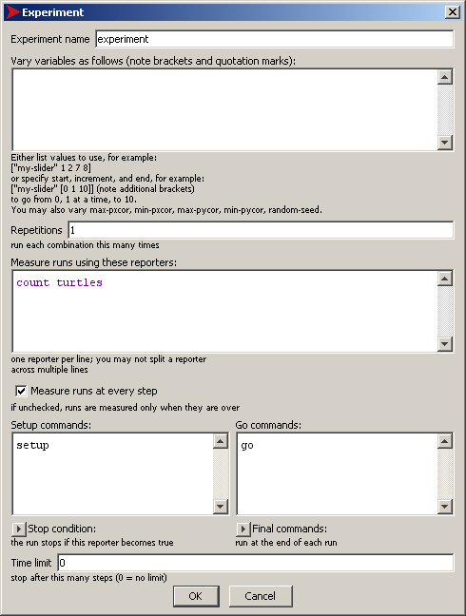
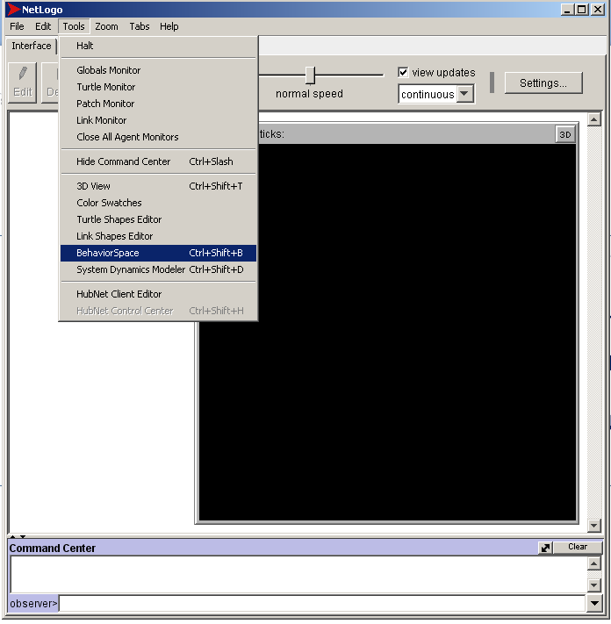
Using BehaviorSpace with R
To open: Tools –> BehaviorSpace
Notes:
TODO: prepare example

Slide 18
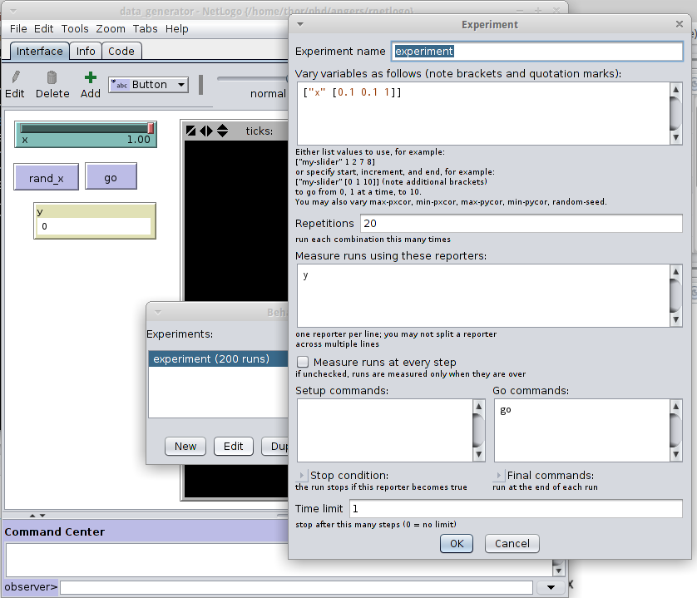
Using BehaviorSpace with R
Define experiment
Save to .csv
Read with R
Analyze

Slide 19
Explore It!

Slide 20
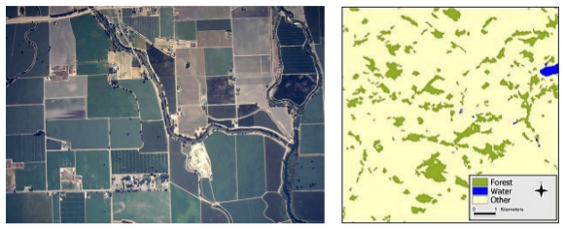
Application: Fragmented Landscapes

Slide 21
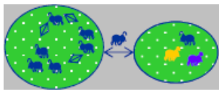
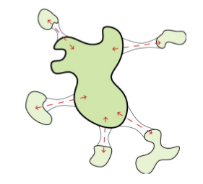
Effect to Meta(Populations)?

Slide 22
Measure the effect!
Connectivity: Probability that an individual, starting at habitat i, reaches habitat j
What is the relation between distance and connectivity?
Makro Approach
f(dist., speed, mortality)
= connectivity
Micro Approach
Use Agent-based modeling!

Slide 23
Assignment I: extension [r]
Open ‘Correlated Random Walk’ model
Familiarize yourself with the model
Observe the ‘turtle diffusion’
Describe the diffusion with R-extension
Descriptive statistics?
E.g. mean, standard deviation
Is diffusion normally distributed?
E.g. hist(), qqnorm(), qqline(), shapiro.test(), ...
Visualize the diffusion
E.g. plot(), smoothScatter(), ...

Slide 24
Assignment II: Behavior space and RNetLogo
Formulate a hypothesis about how distance to habitat is related to connectivity
Design an experiment to test it
Use both BehaviorSpace and NetLogo
→ Do the results support your hypothesis?
?
connectivity
distance

Slide 25
Have fun!

